Slide 1


Slide 2
About Us
Floor Plan
Budget
Networking Hardware
POS Research
Software Research
Security Policies
Database Demonstration
Website Demonstration
Packet Tracer Demonstration
Cybersecurity Results
Agenda

Slide 3
Organizational Chart
Page: 3
Ryan Gault,
Network
Engineer
CJ George,
Back-End Developer
De'Anna Jones,
Project
Manager
Gavin Smithson,
Full-Stack Developer
Thomas Wolf,
Front-End Developer

Slide 4
Mission Statement
Page: 3
Flare Sparx Intelligence strives to provide our clients with efficient and cutting-edge technology solutions with room for growth that allows their business to thrive in the fast-paced and rapidly growing digital age.

Slide 5


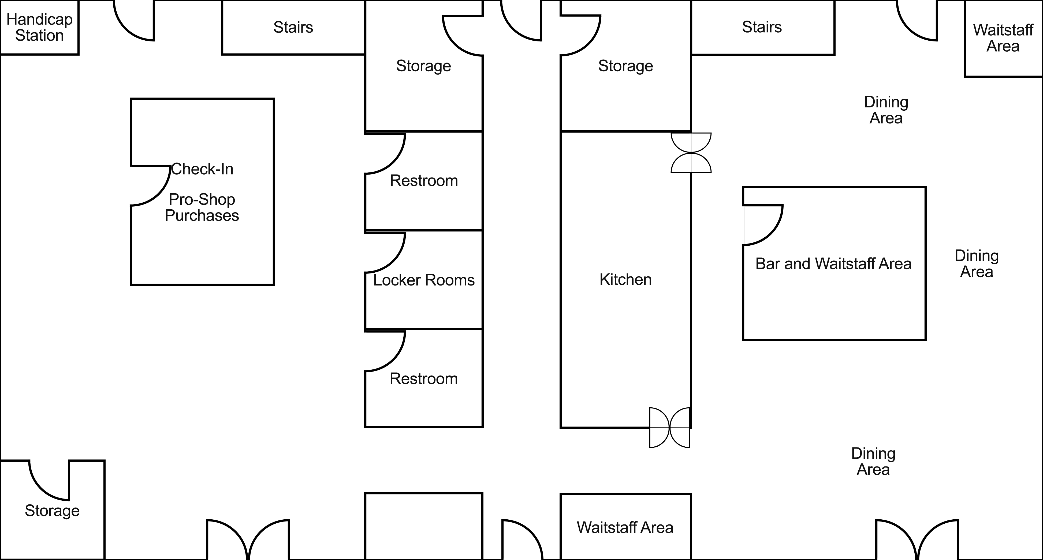









1st Floor
Page: 27
POS with Cash:
Mobile POS:
UPS:
CCTV Camera:
Pin Pad Lock:
Ethernet Drop:
Ethernet Cable:
Switch:
Access Point:
VOIP Phone:

Slide 6

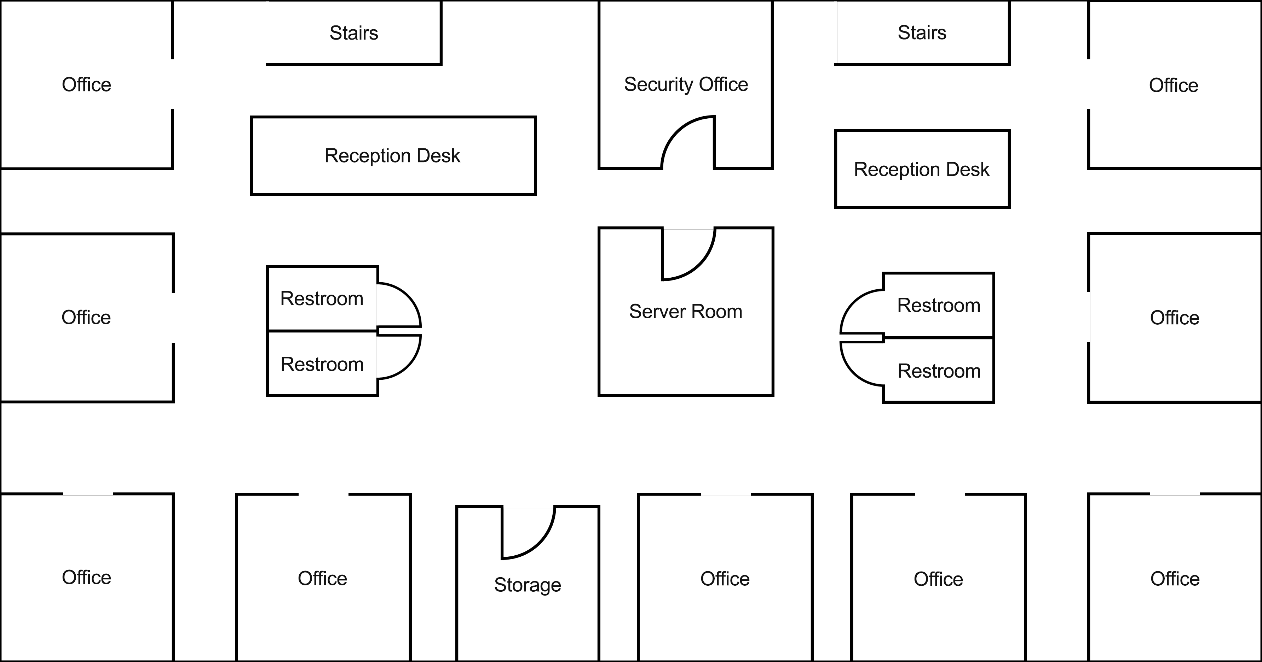





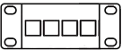
2nd Floor
Page: 28
Desktop:
Monitor:
Server:
UPS:
Server UPS:
CCTV Camera:
Pin Pad Lock:
Biometric Lock:
Ethernet Drop:
Ethernet Cable:
Switch:
Access Point:
VOIP Phone:
Printer:
Patch Panel:

Slide 7
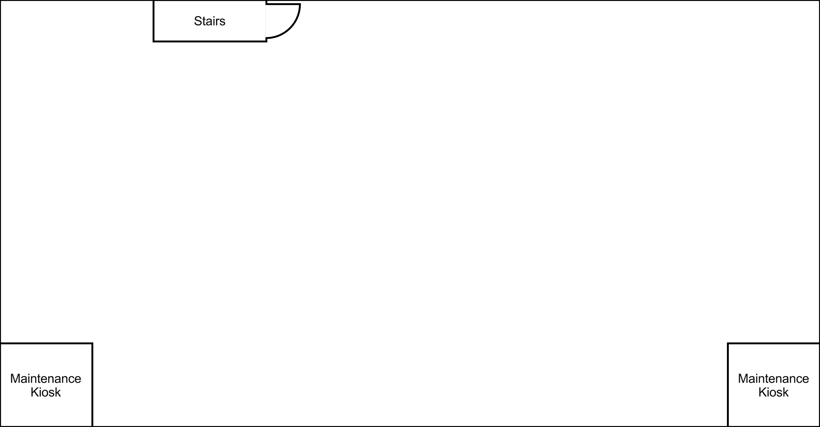

Basement
Page: 29
Kiosk:
UPS:
CCTV Camera:
Pin Pad Lock:
Ethernet Drop:
Ethernet Cable:
Switch:
Access Point:
VOIP Phone:

Slide 8
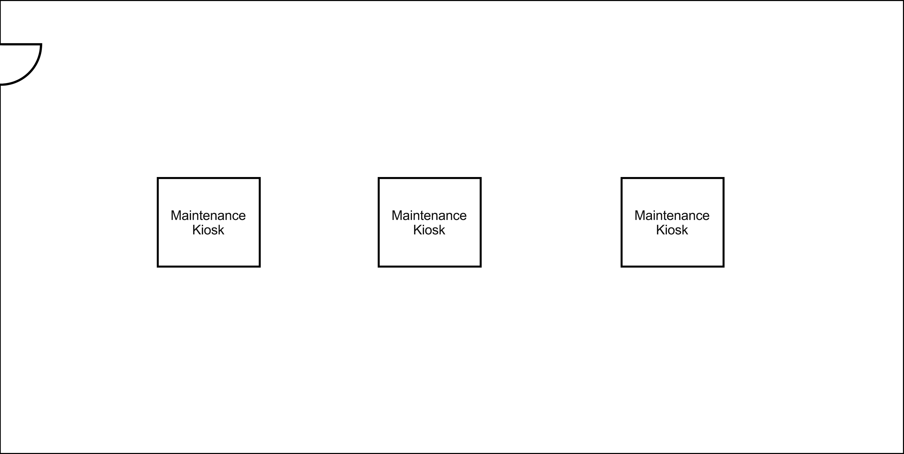

Maintenance Shed
Page: 30
Kiosk:
UPS:
CCTV Camera:
Biometric Lock:
Service Poles:
Ethernet Cable:
Switch:
Access Point:
VOIP Phone:

Slide 9
Page: 33

Slide 10
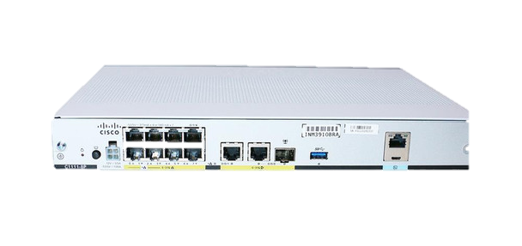
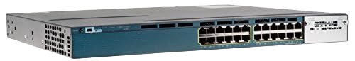
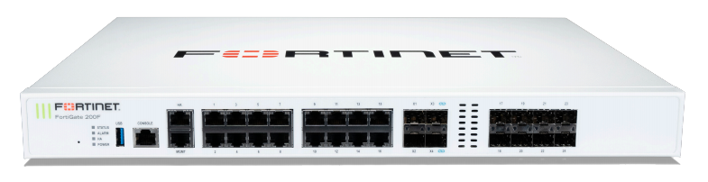
Page: 42 & 43
Networking Hardware Recommendations
C1111 Cisco Router | C3560X Cisco Switch | Fortinet Fortigate 200F
Runs 802.11ax Management Ports 8-Gbit Ports | Uses Gbit Ports 24 Full-Duplex Ports Layer 3 Switch | Software-Defined Wide Area Network (SD-WAN)​ Continuous Risk Assessment​ Wi-Fi Protected Setup (WPS)

Slide 11
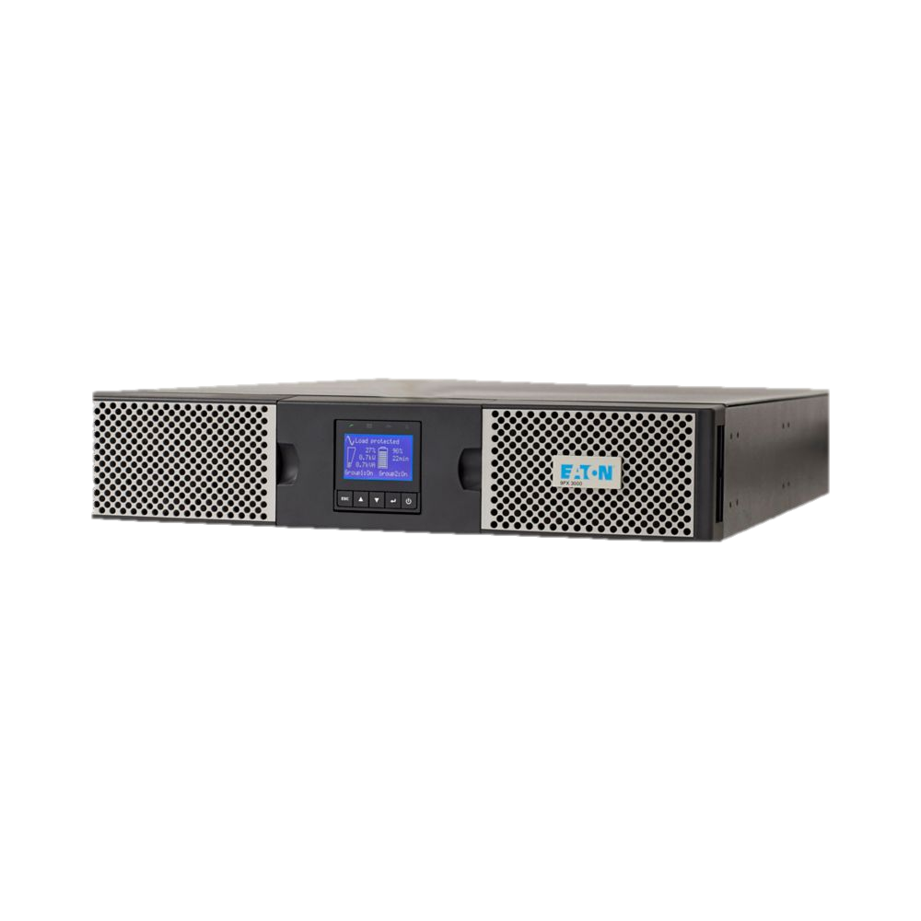
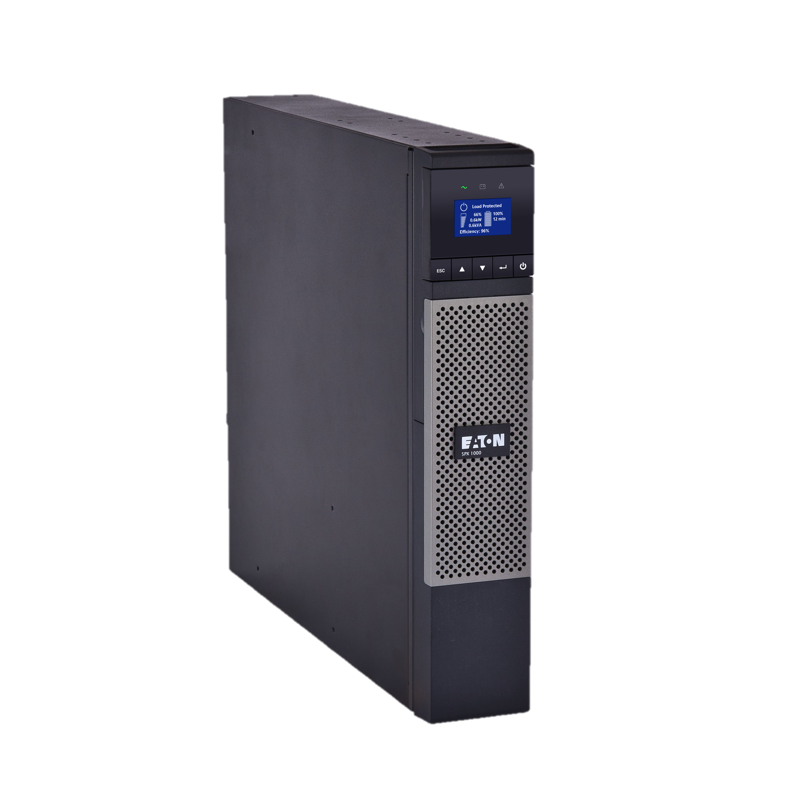
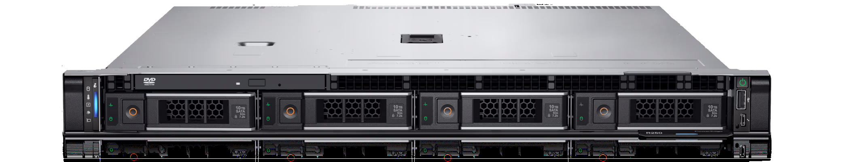
Page: 44 & 45
Networking Hardware Recommendations
PowerEdge R250 Server | Eaton 9PX Server UPS | Eaton 5PX Office UPS
System Lockdown Settings Secure Boot/Erase Cryptographically Secure Booting | 64 Minute Runtime 1,350 Watt, 1,500 VA 3-Stage Charging | 54 Minute Runtime 1,000 Watt, 1,000 VA Line-Active

Slide 12
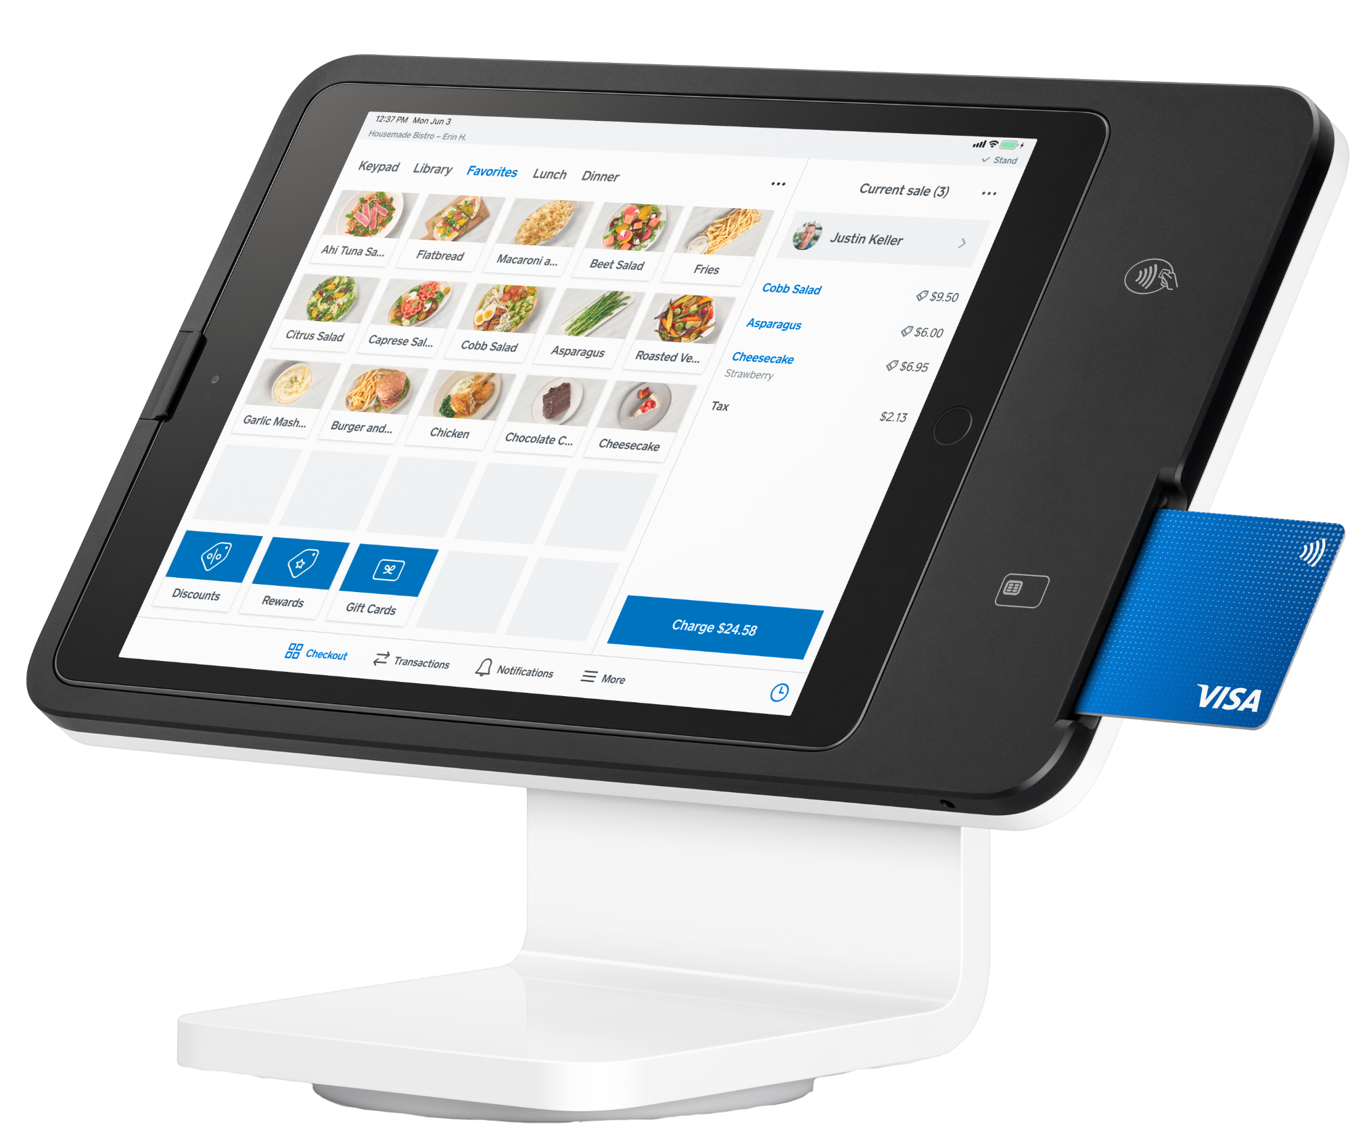
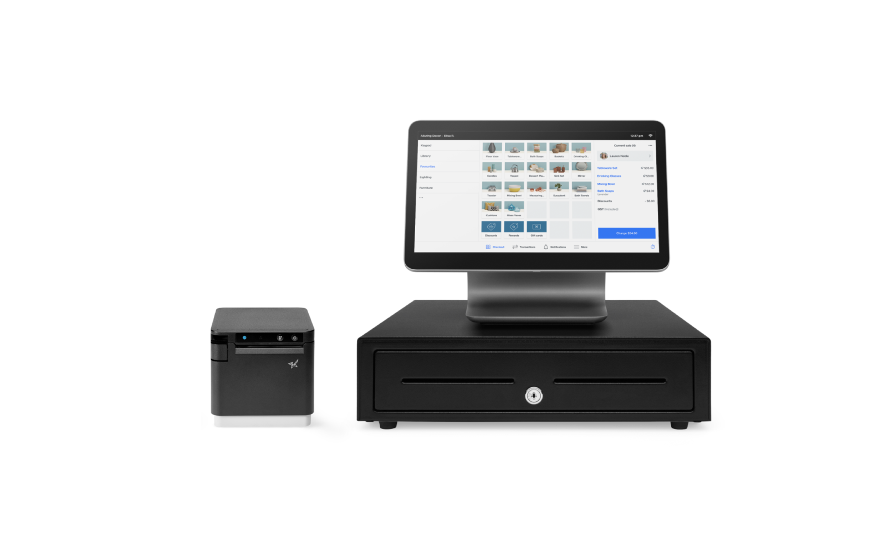
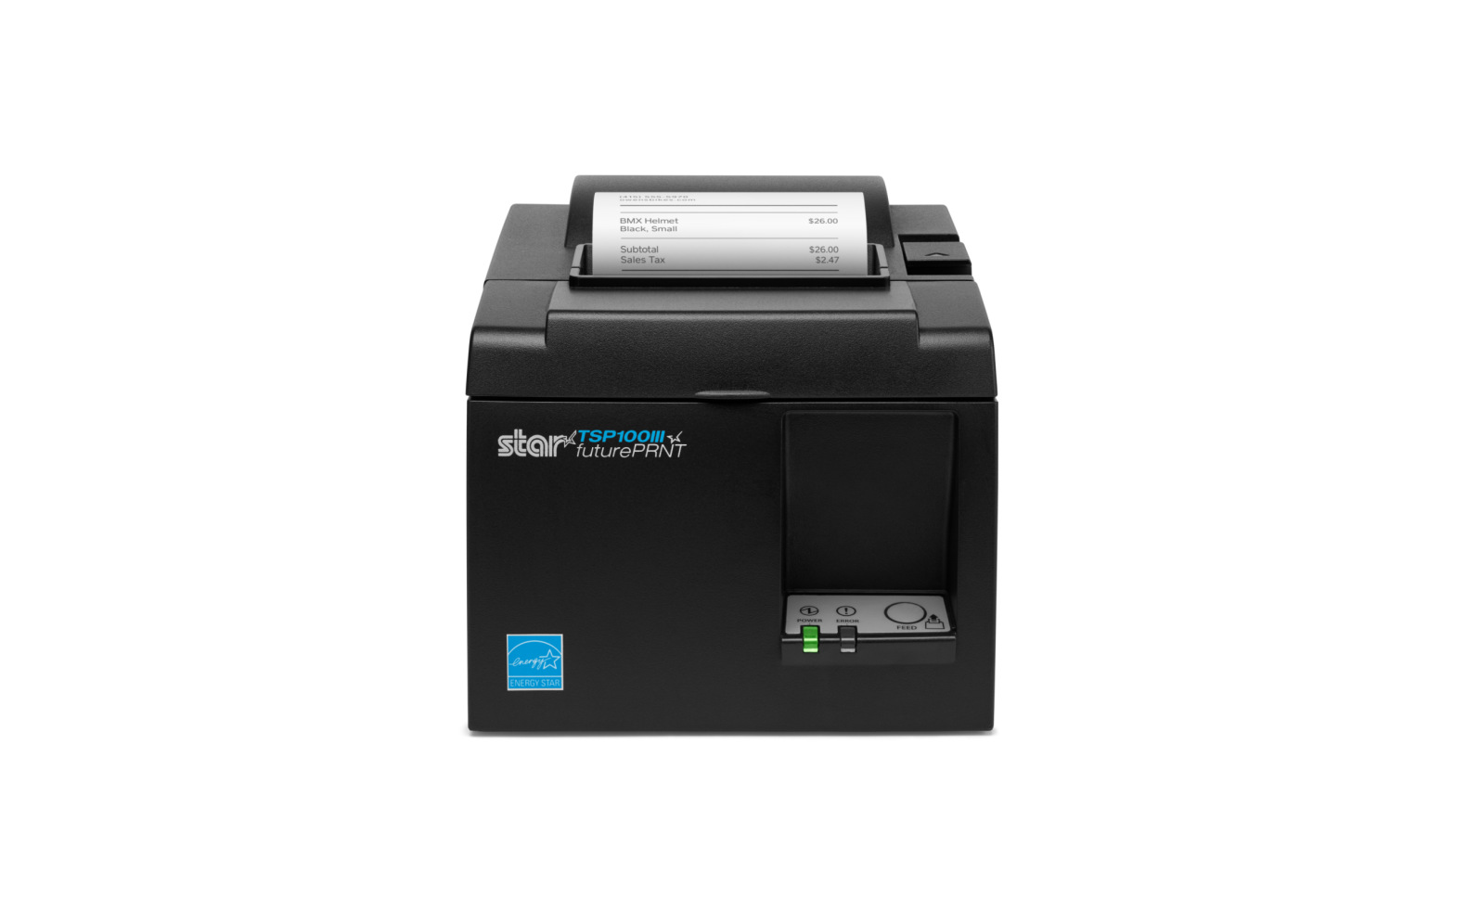
Page: 46 & 47
POS Hardware Recommendations
Square Stand | Square Register | Star Micronics Receipt Printer
Features Tap, Chip, and Swipe Utilizes Square Software Suite | Features a Detachable Customer-Facing Display Attached Cash Register | Thermal Printer 230 ft Length Additional Rolls Are $78.00 Per 25 Pack

Slide 13
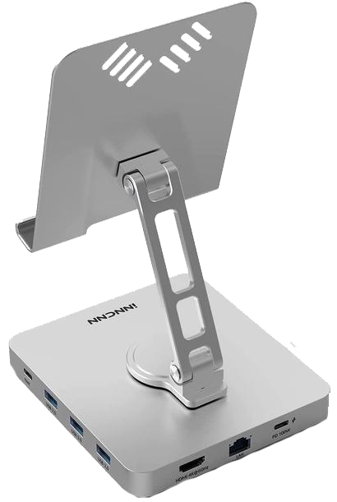
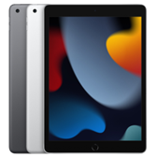
Page: 47 & 48
POS Hardware Recommendations
iPad Ninth Generation 10.2 In | NewEgg iPad Dock Hub
Useful for waitstaff and maintenance 10.2 Inch Display Access to iOS | USB-C 100 watt charging port USB-A 3.0 data port RJ45 1000 mbps Ethernet port

Slide 14

Page: 59
POS Software Recommendations
 | Square Software Suite
 | Omnichannel Payment Processing Real-time Analytics Third Parties Integrations

Slide 15



Page: 61 & 62
Server Software Recommendations
FortiOS 7.4 | Linux with LAMP Stack | Microsoft SQL Server
Integrated Security and Networking Fortinet Security Fabric Real-Time Network Visibility | Good for Heavy Traffic Large Community Support and Resources Robust Security Features | Database Engine Features Support for Multiple Users Includes Suites of Tools for Database Management

Slide 16
Page: 82 - 88
Security Policies
Data Backup Policy | Disaster Recovery Policy | Password Protection Policy
Scheduled Daily and Weekly Backups for Data Secure On-Site and Off-Site Storage Regular Backup Verification Tests Defined Roles for Accountability | Recover IT Systems, Applications, and Data Various Contingency Plans are Utilized Practice and Annual Tabletop Exercises should be Conducted Infosec Team will Verify Compliance | Authorized Password Mangers Permitted Separate, Unique Password for Each Account Multi-Factor Authentication Highly Recommended “Remember Password” Feature Not Permitted

Slide 17
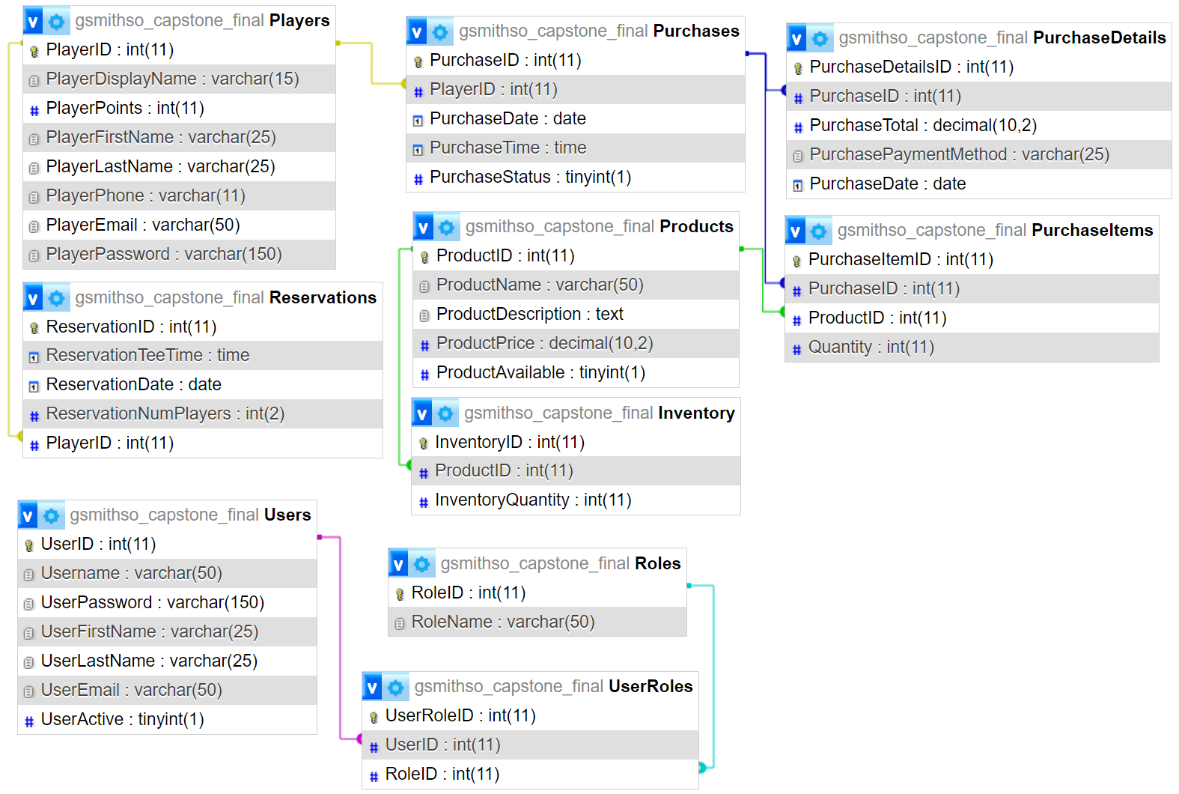
Database Demonstration
Page: 93

Slide 18
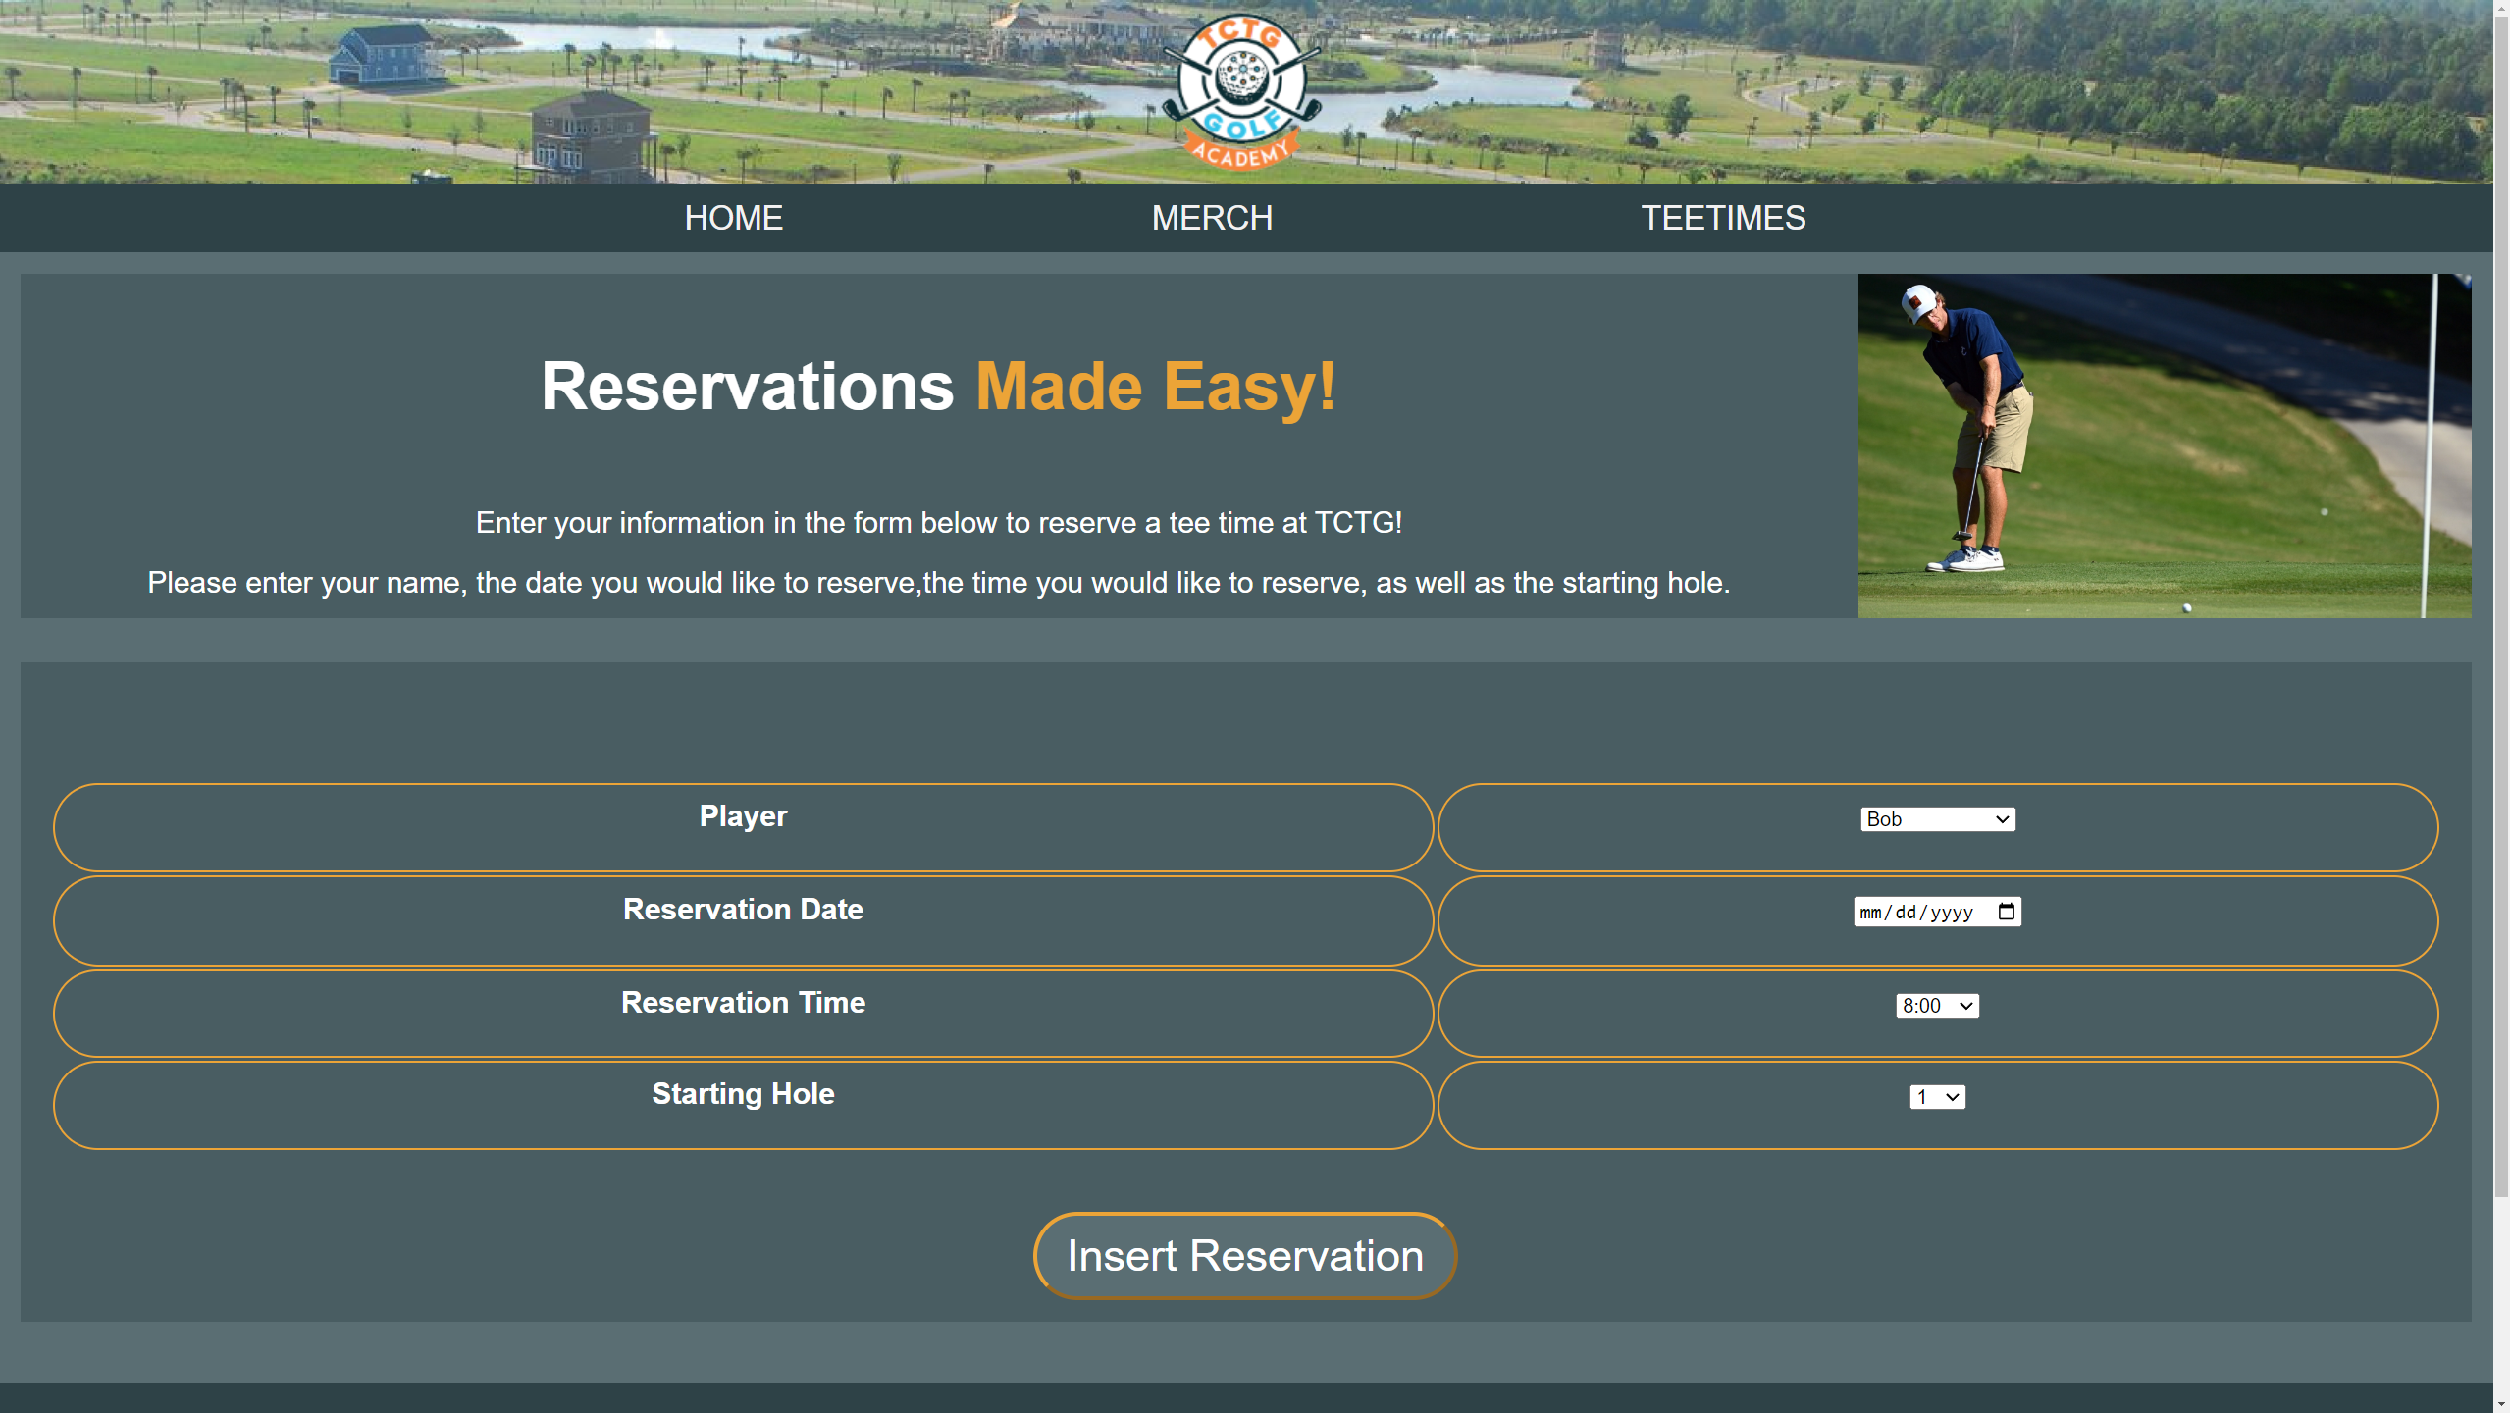
Page: 93 - 101
Website Demonstration

Slide 19
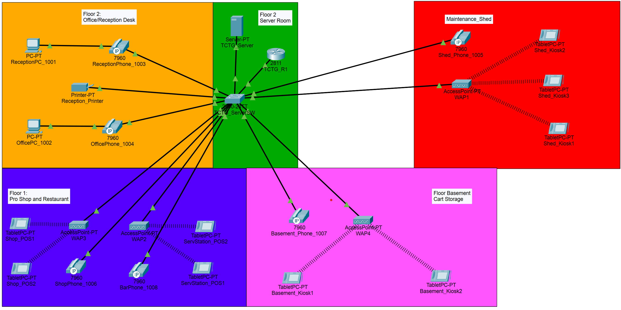
Packet Tracker Demonstration
Page: 102

Slide 20
Cybersecurity Results
Implementation
Results
Close All Unused Ports
Enable Firewall
Fortify Passwords Following Password Policies
Change Passwords If Compromised
Open Ports
Default Passwords and
Usernames

Slide 21
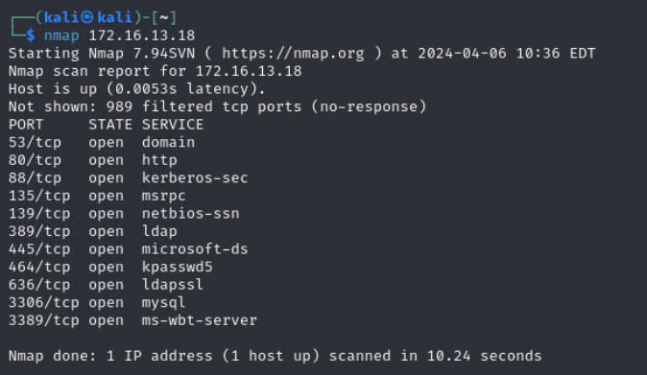
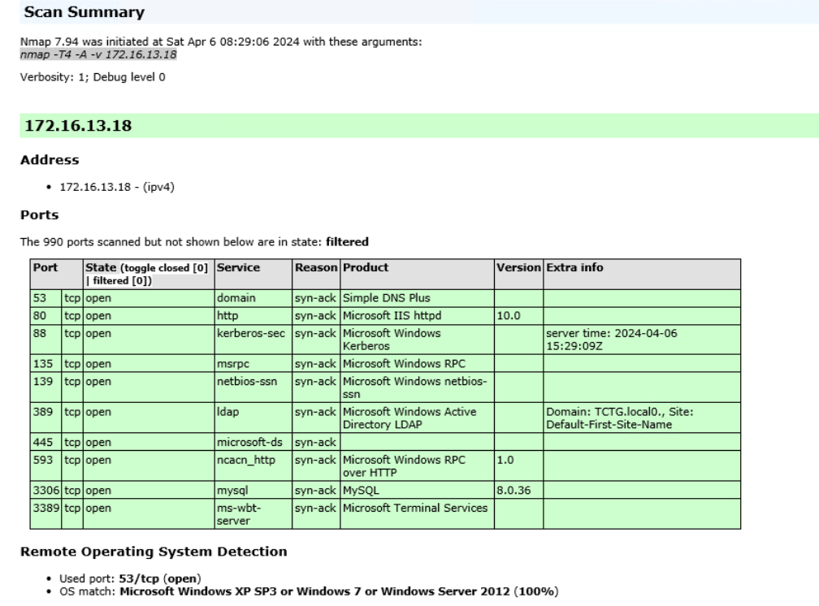
Cybersecurity Results

Slide 22
About Us
Floor Plan
Budget
Networking Hardware
POS Research
Software Research
Security Policies
Database Demonstration
Website Demonstration
Packet Tracer Demonstration
Cybersecurity Results
Summary

Slide 23

Conclusion
Thank You!
Any Questions?

